Slide 1
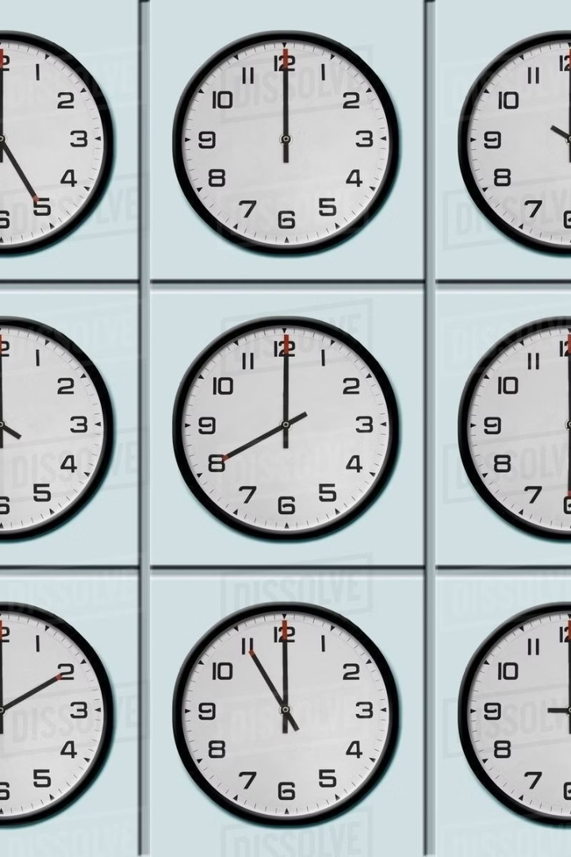

World Clock
A Simple and Effective Global Time Solution
Presented By:
Soumya Ranjan Patel
Regd No.: 2221298016
Soumya Ranjan Behera
Regd No.: 2221298015
Under the supervision of: Subhashree Shukla

Slide 2
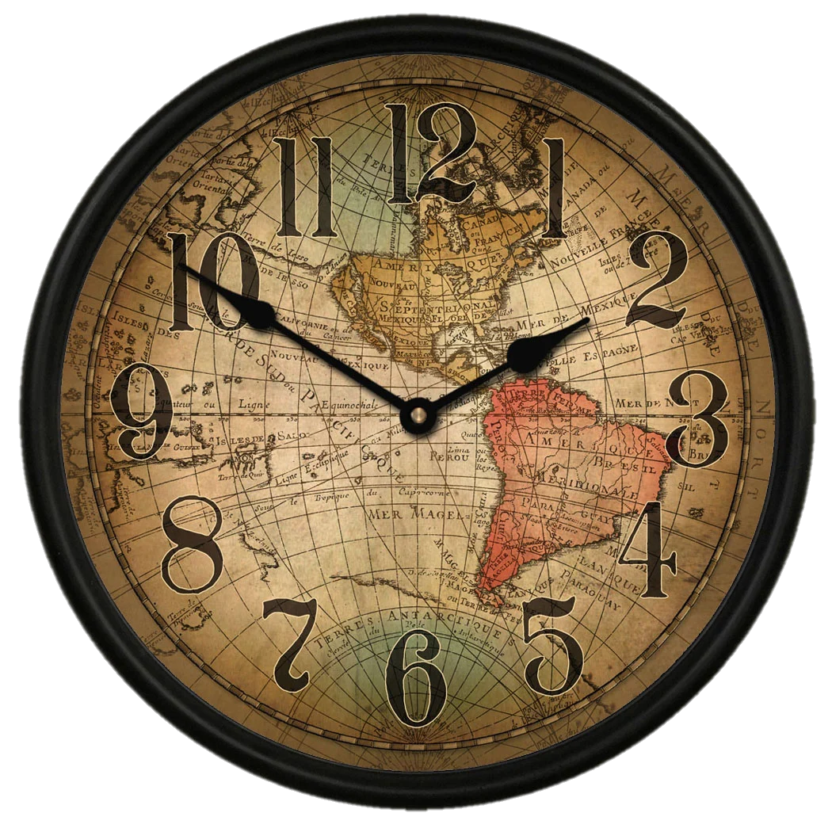
CONTENT
1. INTRODUCTION
2. FEATURES
3. HOW IT WORKS
4. DESIGN
5. USE CASES
6. FUTURE DEVELOPMENTS
7. CONCLUSION

Slide 3
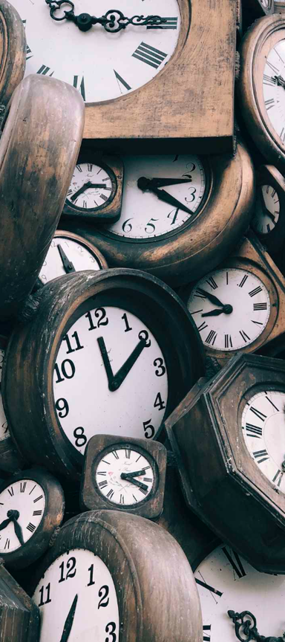
INTRODUCTION
Welcome, everyone!
Today, we're delving into the realm of global time management with the “World Clock”. Let's explore how this simple tool can enhance our understanding of time zones and streamline coordination in our interconnected world.

Slide 4
Key Features
1
User-friendly Interface
2
Real-time Updates
3
Access to Global Time Zones
Easy-to-navigate design for seamless interaction.
Automatic and instant time zone updates.
View time from all over the world in one place.

Slide 5
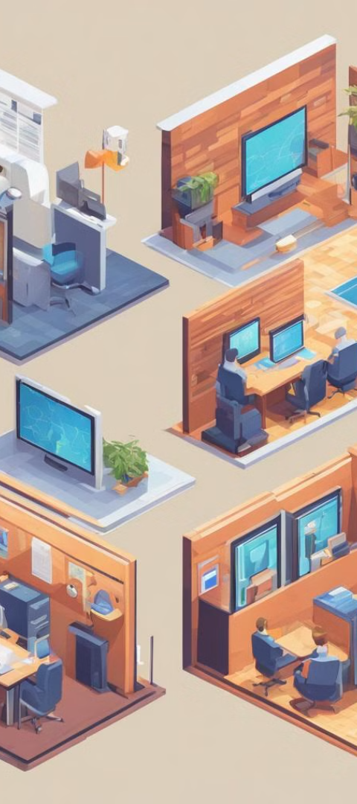
How It Works
?
Synchronization with World Time Servers
"Our system establishes a global connection to precise time references through the assistance of <cdn.jsdeliver.net>. This content delivery network not only facilitates seamless connectivity but also ensures the provision of accurate time, enhancing the reliability and precision of our timekeeping across the globe."

Slide 6
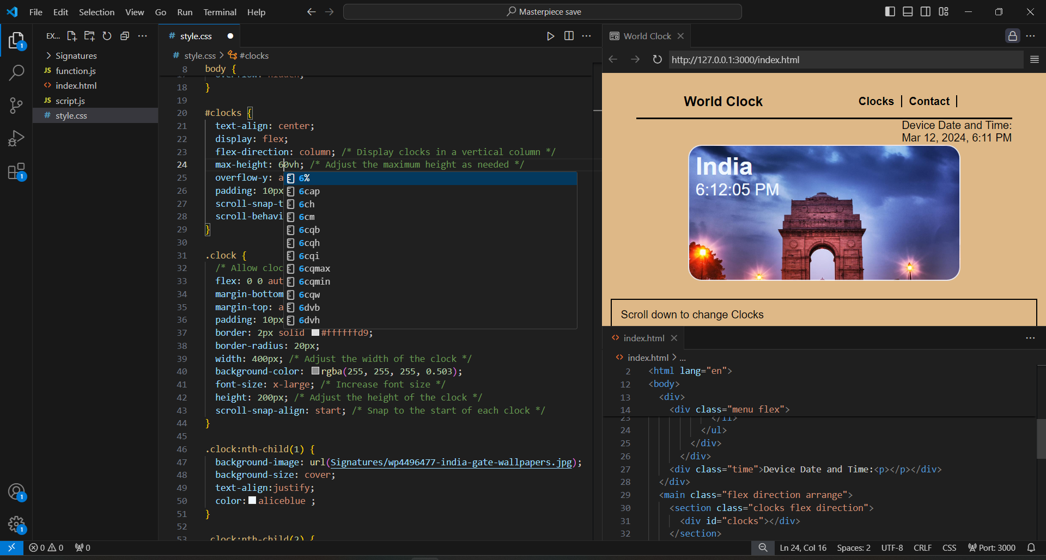
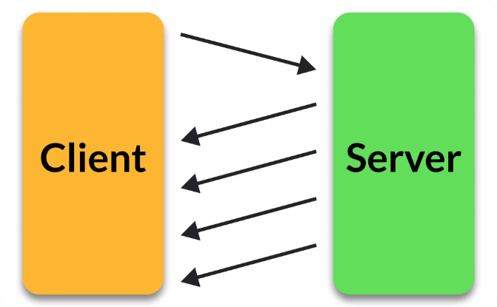
User-Friendly Design
Intuitive UI
Real-time Updates
A user-friendly interface for easy time zone management.
Updates displayed in real-time for accurate scheduling.

Slide 7
Practical Use Cases
Coordinate Global Meetings
Plan International Collaborations
Simplify Travel Planning
Easily schedule meetings across different time zones.
Efficiently plan projects with teams in diverse locations.
Organize travel while accounting for time differences.

Slide 8
Future Developments
1
2
3
User Feedback and Improvements
Additional Time Zones
Exciting Updates
Anticipate new and exciting features in upcoming releases.
Continuous improvements driven by user input.
Enhance with more time zones based on demand.

Slide 9
CONCLUSION
In conclusion, the world clock is more than just a timekeeping tool; it's a bridge that connects us globally. It helps us coordinate across different time zones and appreciate the diverse ways people perceive time. Time is universal, so is World Clock.

Slide 10
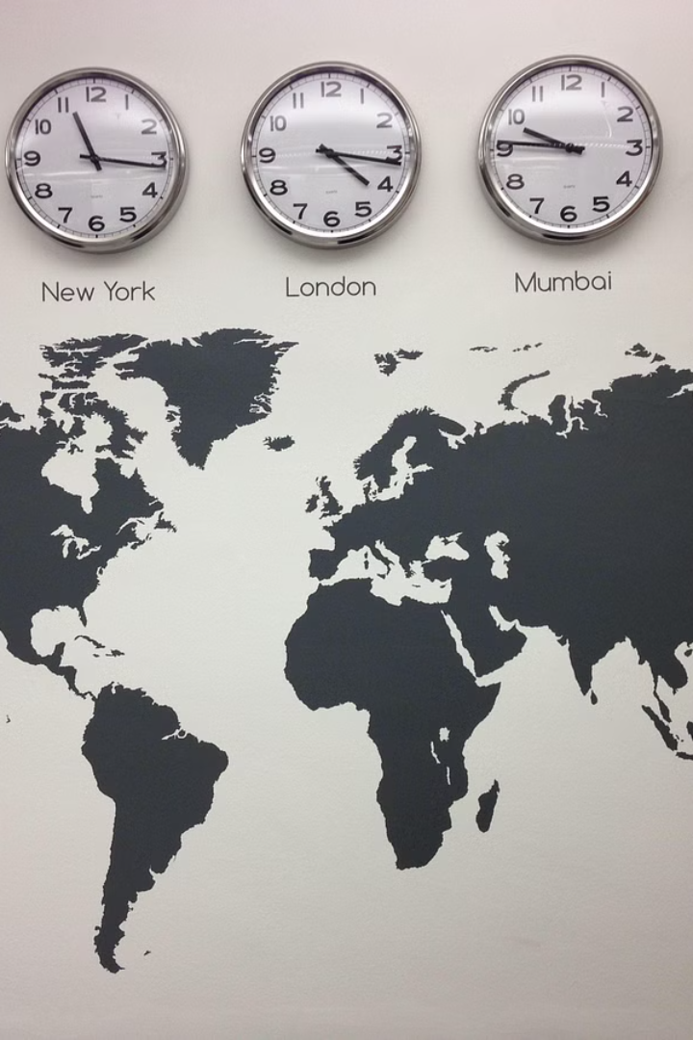
Thank You!

